Slide 1
IBM DeepQA
Watson and the Jeopardy! Challenge
Michael Sanchez

Slide 2
What is DeepQA?
QA – Question Answering
Systems designed to answer questions posed in natural language
Goal – create a system capable of playing Jeopardy! at human championship level
In real time
IBM’s follow up project to DeepBlue

Slide 3
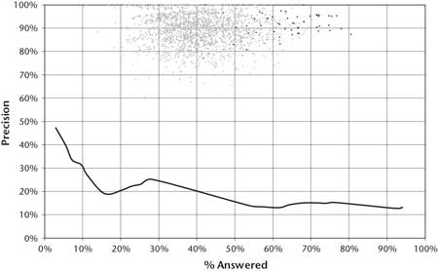
Initial Performance
Notes:
Baseline performance of adapted PIQUANT (Practical Intelligent Question Answering Technology) to Jeopardy! challenge.
Had been in development for several years prior
One of the top 3-5 in TREC (Text Retrieval Conference) QA system.
Winners cloud - % of questions answered vs. % correct for winners. Dark dots = Ken Jennings
PIQUANT – 5% of question it most confident in, correct < 50% of the time

Slide 4
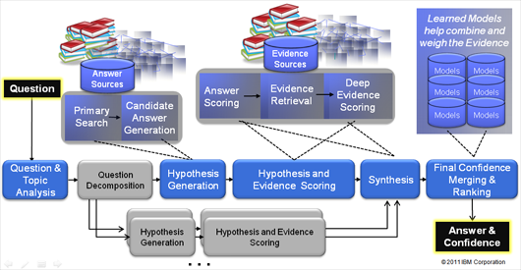
DeepQA Architecture
Notes:
Major overhaul from PIQUANT system.
Massively parallel, probabilistic, evidence based
Every step done multiple different ways, scored, and weighted.

Slide 5
Content Acquisition
Take an initial corpus of documents
Unstructured data
For Jeopardy! – roughly ~400 TB of data
Including all of Wikipedia
Parsed into “Syntactic Frames”
Subject-Verb-Object
Generalized into “Semantic Frames”
Probability associated
Forms a “Semantic Net”
Notes:
Inventors patent inventions (.8)
Fluid is a liquid (.6)
Liquid is a fluid (.5)
Vessels sink (.7)
People sink 8-balls (.5) – (.8 in pool)
400 TB -> 20 TB for Semantic Net
Semantic Net kept for searches

Slide 6
Question Analysis
Attempt to understand what the question is asking
Many different approaches are taken
Attempting to come up with all possible interpretation of the question
Notes:
Question Classification – what type of question? Puzzle, math, definition
Focus/LAT:
Focus – what the question is asking about
LAT - lexical answer type, single word that determines the type of answer
Relation Detection
Decomposition – break question into more easily answered subquestions

Slide 7
Hypothesis Generation
Primary Search – Attempt to come up with as much answer content as possible from sources
Various search techniques
85% of time correct answer within top 250 at this stage
Candidate Answer Generation – Use appropriate techniques to extract answer from content
Filter – Lightweight scoring of candidate answers
~100 answers let through
Notes:
Primary Search Techniques
Multiple Text search engines
Document Search
Passage Search
etc…
Recall vs. precisions
As many answer as possible – if answer isn’t here, Watson can’t get it!
Candidate Answer Generation
if “title base search”, extract title as answer

Slide 8
Hypothesis Scoring
Retrieve additional evidence supporting each candidate answer that passed filtering
Score the candidate answers based on supporting evidence
More than 50 different types of scoring methods
Ex. Temporal, Geospatial, Popularity, Source Reliability
Notes:
Temporal – Time reference
Geospatial – spatial relationship – boundaries, relative locations

Slide 9
Result Merging
Identify related answers and combine their scores
Generate confidence estimation
Indicates how confident in the answer the system is
System training is important here
Different question types might weigh scores differently
Probabilistic
Results are then ranked on confidence
Highest confidence = best answer
Notes:
Abe Lincoln + Honest Abe – same answer/related, merge results
Confidence based on how good the scores are.
Ability to learn dynamically what a category is asking for.

Slide 10
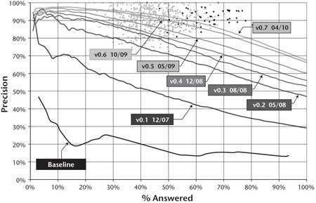
DeepQA Performance
Notes:
Initial jump in performance when DeepQA architecture implemented
Incremental improvements followed over time

Slide 11
DeepQA on Watson
With a single CPU - ~ 2 hours to get an answer
Not fast enough for Jeopardy!
Questions take ~ 3 seconds on average to read
Take advantage of the parallel capabilities of DeepQA
90 Power 750 servers = 2880 CPUs
80 TFLOPS
Able to answer in 3-5 seconds
Notes:
Embarrassingly parallel
POWER7 CPU = 8C / 32T
16 TB RAM
Was ranked 94th in Top 500 super computers
200M pages of data -> 4TB disk storage.
RAM used for speed

Slide 12
Jeopardy! Challenge
In January 2011 Watson competed against two of the best Jeopardy! Champions
Ken Jennings – $3,172,700 in winnings
Brad Rutter - $3,470,102 in winnings
Two matches played
Questions chosen from unaired episodes
Notes:
Airdates February 14 & 15th 2011
IBM worried questions would be created to deliberately take advantage of Watson’s weaknesses. Unaired questions compromise

Slide 13
Outcome
First Game
Watson wins - $35,734
Rutter - $10,400, Jennings - $4,800
Second Game
Watson - $77,147
Jennings - $24,000, Rutter - $21,600
Notes:
Watson only rang in if confidence high enough.
- Defaults to 50%, but can shift.
Demonstrates complicated betting strategies depending on game state
- If large lead, more conservative

Slide 14
Future Applications
Take advantage of DeepQA’s ability to process large amounts of unstructured Data
Medicine
Amount of data increasing doubling every 5 years
Almost entirely unstructured
Finance
5 documents from Wall Street every minute
Millions of transactions
Notes:
Memorial Sloan-Kettering Cancer Center
Citi

Slide 15
Questions?
“I for one welcome our new computer overlords”
–Ken Jennings

Slide 16
References
The AI Behind Watson: http://www.aaai.org/Magazine/Watson/watson.php
What is Watson?: http://static.usenix.org/event/lisa11/tech/slides/perrone.pdf
Building Watson: http://www.youtube.com/watch?v=3G2H3DZ8rNc
IBM Watson: The Science Behind an Answer: http://ieeexplore.ieee.org/xpl/tocresult.jsp?isnumber=6177717
Watson: http://en.wikipedia.org/wiki/Watson_%28computer%29
Question Answering: http://en.wikipedia.org/wiki/Question_answering
DeepQA Research Team: http://researcher.watson.ibm.com/researcher/view_project_subpage.php?id=2159

